Slide 1

CAN WE HAVE YOUR IMMEDIATE ATTENTION???
Changes and updates in the HHGs transportation area

Slide 2
WHY?

Slide 4

BAY AREA

Slide 5
REALLY,
THIS TOO??

Slide 6
SO WHAT’S THE GOOD NEWS

Slide 7
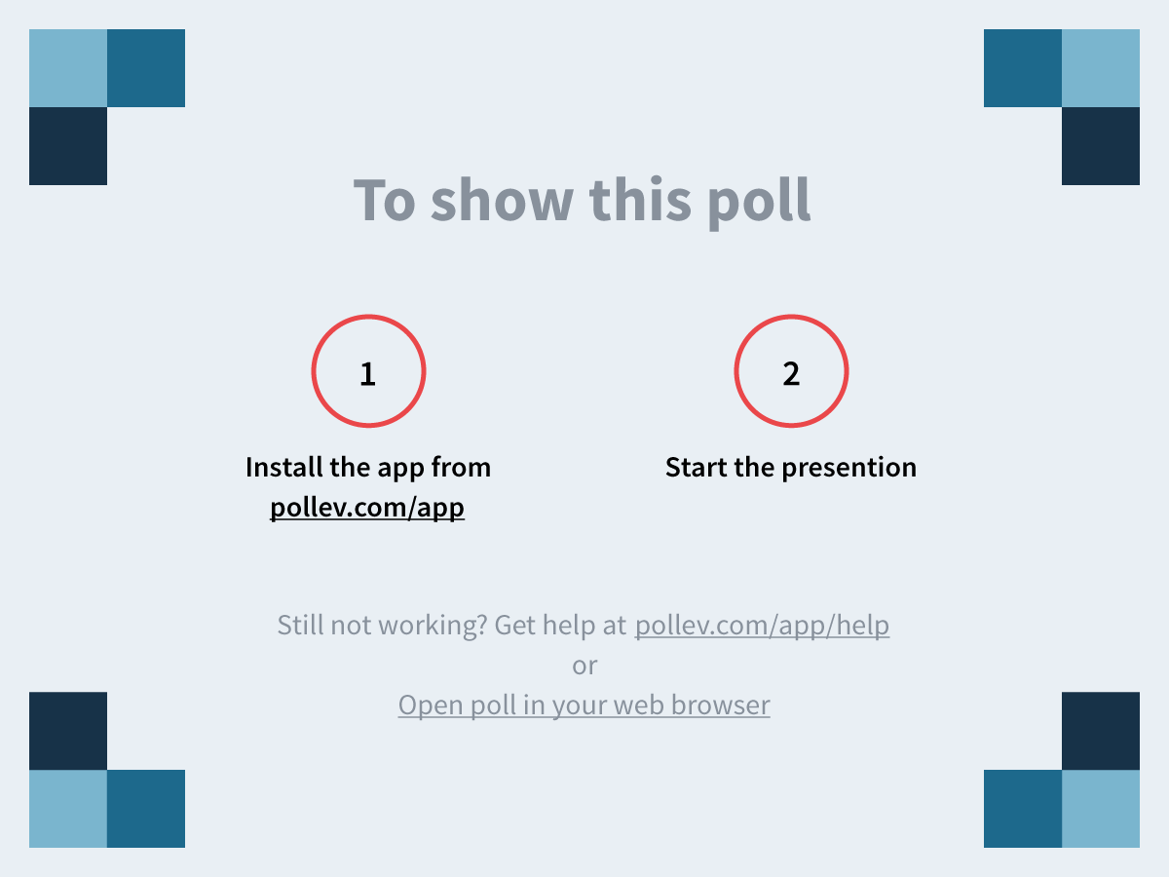
Notes:
Questions?
https://www.polleverywhere.com/free_text_polls/cLXmwB0vN0hh7Uf

