Slide 1

Driving Compliance with Big Data
& Automation

Slide 2
Agenda
Introductions
What are we talking about?
Workplace Impact of Big Data, AI and Automation
Impact on GM & Compliance
Applications for GM and across the Enterprise
Case Studies
Questions & Answers (we hope!)

Slide 3



Introductions
William Taylor
Partner
Fakhoury Global Immigration
Andreas Strohschein
Sr. Manager, Global Mobility & Immigration
McKesson
Anupam Singhal
Co-Founder & CEO
Monaeo

Slide 4

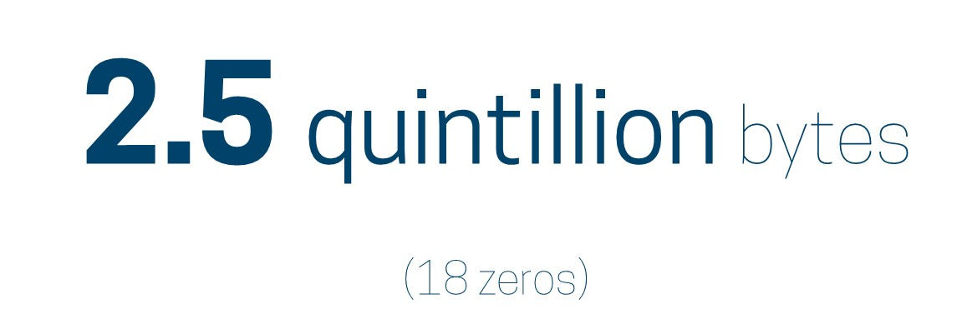
“Big Data.” Really?
2.5 quintillion bytes
(18 zeros)

Slide 5

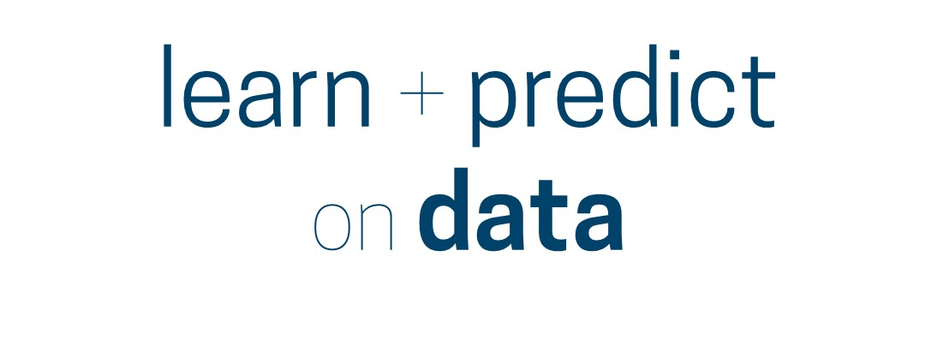

Slide 6



Slide 7

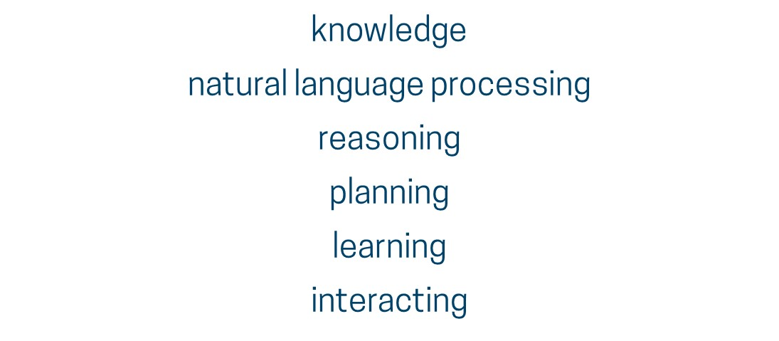

Slide 8
Workplace Impact
January 2017 McKinsey Global Institute study
Automation will displace jobs gradually
Measured pace likely as what is technically possible is only one factor
49% of time spent on work activities could be automated with “currently demonstrated technology” either already in the marketplace or being developed in labs
  Equates to $15.8 trillion in wages and the equivalent of 1.1 billion workers worldwide
But only 5 percent of jobs can be entirely automated!

Slide 9
Workplace Impact
November 2017 McKinsey Global Institute study UPDATED!
39 million to 73 million jobs could be destroyed by 2030
~20 million of those displaced will shift into similar roles
16 to 54 million workers — 1/3 of the U.S. workforce — will need to be retrained for entirely new occupations
Globally, up to 800 million workers could be displaced and as many as 375 million may need to learn new skills for new occupational categories

Slide 10

Day in the life of GM
  Largely reactive
    Too much time on tactical issues and service coordination
  Lack of automation
    Manual processes
    Too many systems that rarely speak to each other
  At the center of info that impacts various corporate functions
    Payroll, Corporate Tax, Legal, Benefits, Talent, Sales, Finance, Travel, Employee Safety/Duty of Care

Slide 11
(R)evolution in Mobility
Automation of core mobility
Rise of unstructured mobility
Evolving corporate environment

Slide 12
Ad-hoc travel, Remote working, Telecommuting…
Multi-dimensional transformation
People: companies’ most valuable asset
Generational shifts: flexibility most desirable in a job
Tech: enabling employee productivity, wherever they are
Bottom line: Evolution beyond traditional mobility means companies are losing visibility into their most valuable asset and GM is left blindsided.

Slide 13
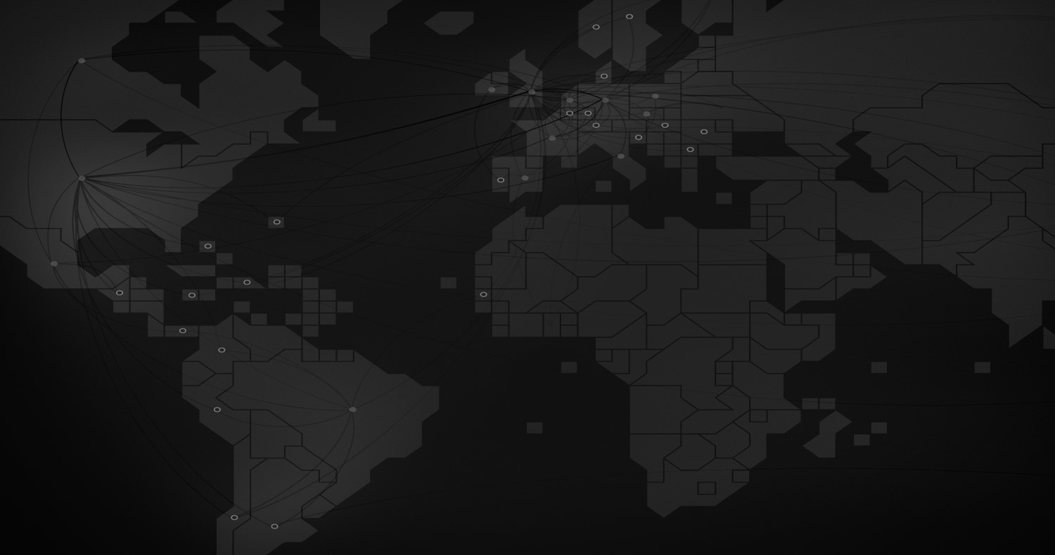
Simple Questions
Where are your employees located?
How much are they moving around?
Why are they there?
What risks, exposures & opportunities are being created?
How can you act on them?

Slide 14

Technology unlocks the power of data
  Streamlines processes | Increased visibility | Proactive compliance | Peace of Mind

Slide 15

Case Study
West Coast-based company
~5,000 employees nationwide
NYS audit years 2010 to 2012; expands into 2014 and 2015 during audit
Audit method: 2012 test year
Total withholding audit bill - $5,000,000!
NY TAX AUDIT

Slide 16
Case Study
Global enterprise technology leader with ~20k employees worldwide
GM led payroll to initiate compliance in high-risk jurisdictions to plug $3 million exposure through better data visibility
Drove tens of millions in savings in collaboration with Corporate Tax armed with hard analytics (Nexus/PE)
Delivered process efficiency and no net increase in workload through process automation
But wait…there’s more!

Slide 17
Questions and Answers

