Slide 1
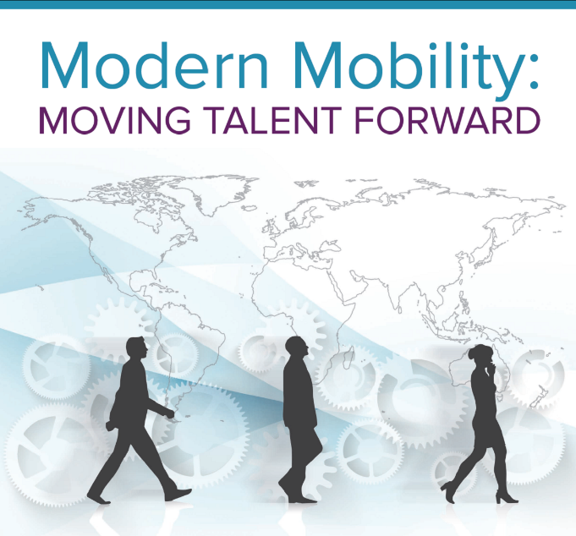
Decoding Millennial Mobility: Value, Choice, and Flexibility
Presentation to Bay Area Mobility Managers

Slide 2
Stephanie Borgeson
Client Engagement Manager
sborgeson@air-inc.com
AIRINC
Decoding Millennial Mobility: Value, Choice, and Flexibility
Linda Parker Pennington
Sr. Director Business Development
lpennington@air-inc.com
AIRINC
Natacha Sittner
Head, Talent Mobility
Netflix
AMERICAS
AIRINC Global Headquarters Cambridge, MA United States of America T +1 617 354 2133
EMEA
Brussels, Belgium T +32 (0)2 650 0970
Amsterdam, The Netherlands T +31 (0)20 489 3854
London, United Kingdom T +44 (0)20 3514 8650
APAC
Hong Kong T +852 2541 8380

Slide 3
Millennials – a profile
The millennial generation shaking up the workplace rules
?
U.S. Labor Force by Generation, 1995-2015
In millons
Born between 1980-2000
1.8 Billon people globally
Likely to want or expect to work internationally
Desire choice and flexibility
Image credit: US Bureau of Labor Statistics

Slide 4
Why Differentiate Your Policies?
Right package for assignment
Talent management
Pay elements tailored to assignment conditions
Assignments aligned to career development

Slide 5
Policy Choices
Core/Flex
Early in Career/Developmental
Host Plus

Slide 6
Policy Choices
Core/Flex
Who determines the flex components?
Business
Employee
Custom package for each assignee
Administratively heavy

Slide 7
Additional Plus Components
Compensation Components
Core/Flex
Plus Components
+
Home Leave
Education
Core Components
+
Immigration
+
Destination Services
+
COLA/Per Diems
Tax Briefing
Relocation
+
Cultural Training
+
Housing
+
Language Training

Slide 8
Determining the Flex Components: Choose what policy components to receive
Plus Components
Point system
Budget
Menu or Cafeteria Approach
or
or
Employee has points budget to allocate to flex items
Fixed amount to spend on flex benefits

Slide 9
Case Study
Core/Flex
Client Profile
Goal
Fortune 100 US based FMCG Company with a high-end mobility program reserved for strategic business development
Mature talent pool and traditional company culture raising concerns around succession planning and sustainable growth
Leadership initiatives focused on attracting and retaining millennial
Broaden the existing mobility program to attract millennial talent through flexible benefits while simultaneously reducing negotiation environment
Solution
Rationalized program to differentiate core vs. discretionary benefits. With the latter group, created a flex pot – administered by 3P- that allows assignee choice from a list of benefits appealing across generations

Slide 10
Case Study
Core/Flex
Offer a core package based on family and situational needs plus a flexible cash pot of 10K/year against which assignee may claim approved expenses
COMPLIANCE
SUPPORT YOU
LOCATION SPECIFIC
FLEX
Immigration
Tax briefing
Tax eq./assistance
COLA
Transportation
Housing
Settling in Services
Spousal Assistance
Home Leave (cash)
Lease Breaking
Language Training
Temp Living
Education
Hardship
Travel Allowance
Car and Driver
Extra Shipment
Property mgmt.
Extra Leave ticket
Club membership
Continuing Ed
Storage
Vendor reimburses for these expenses up to 10K/year
Situational/not flexible

Slide 11
Policy Choices
Early in Career/Developmental
Targeted to developmental assignments
Often unaccompanied
Company decides what policy components to reduce
Have to back up with talent planning

Slide 12
Policy Choices: One-Way Moves
Host Plus
Housing
Host
Education
Local salary and host payroll
Tax preparation
Home leave

Slide 13
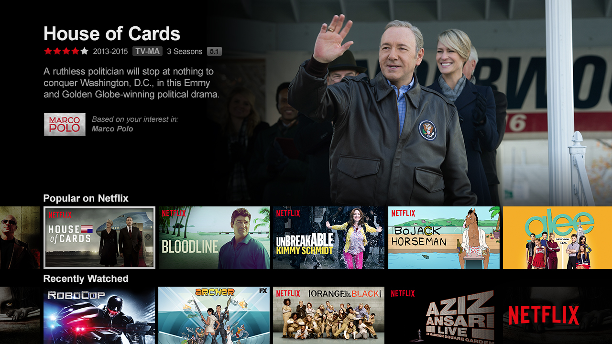
An Overview
At Netflix, everyone gets the freedom to do their best work and the responsibility to achieve excellence. We value candor, transparency, and courage. We embrace context and avoid control, seeking insight and understanding to make sound decisions.
Netflix is 19 years old (founded August 1997) and has 2200 employees, 75 million subscribers, and a global tv entertainment provider with over 125 million hours of watching hours per day #netflixeverywhere
Netflix’s culture of Freedom & Responsibility leads the philosophy of how we manage all our programs and this includes mobility
Netflix’s culture attracts all generations including Millennials

Slide 14
A Look Into Our Program
How do we manage our mobility program and what do we offer?
Candidate offer letters say “we will relocate you”
There is no policy, only a benefit summary of the most requested relocation benefits – discussion starter
Relocation benefits are offered based on employee & family needs, and not driven by a budget or list of allowable/not allowable benefits (except home sale and home purchase)
All relocation is managed by the Talent Mobility team in-house - before handover to the relocation company

Slide 15
Further Considerations
Cash vs. In Kind Benefits
Emerging Markets
vs.
Photo credit: AIRINC surveyor – Mumbai, India 2015

Slide 16
The Importance of Support Services
More cash does not necessarily mean more assignee satisfaction
Providing support services can go a long way to enhancing work effectiveness and family happiness in emerging markets
Pre-assignment visit
Cultural and language training
Involve security; develop emergency plan
Medical support and medevac
Destination services/education support
Spousal support
Sufficient standard of housing and transport
Home leave; R&R for very challenging destinations

Slide 17
Communicating the value to the employee before, during, and after the assignment
Targeting employees with “Global Mindset” and ability to adapt culturally
Setting assignment goals to drive success
Identifying potential roles for the next job within the company
Rewarding assignment with future career growth
International assignment as part of a well developed career plan, including assignee mentoring

Slide 18
Check List
Choosing a Policy –
Do we have the administrative capability to administer a flex policy?
If yes, Core/Plus
How will we administer – budget, points, menu?
If no, Reduced/Developmental
Host Plus:
Are most of our transfers from low wage to high wage?
Do we send people from low cost to high cost locations?
Further Considerations –
Pros and cons of cash vs. in kind benefits
Do we send assignees to high risk locations or emerging markets?
Tie assignments in with talent management –
Communicating the value to the employee before, during, and after the assignment

Slide 19
Thank you!
Stephanie Borgeson
Client Engagement Manager
sborgeson@air-inc.com
AIRINC
Decoding Millennial Mobility: Value, Choice, and Flexibility
Linda Parker Pennington
Sr. Director Business Development
lpennington@air-inc.com
AIRINC
Natacha Sittner
Head, Talent Mobility
Netflix
Questions?

Slide 20
Find out how AIRINC can help you create or improve your global mobility program.
Download free white paper: Establishing Your Optimal Global Mobility Program
or visit us at www.air-inc.com

