Slide 1
Business Immigration and the New Administration
Expectations and Strategies

Slide 2
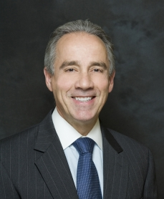
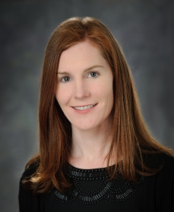
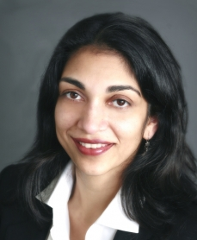
Speakers
Kathy Curtis, SCRP,SGMS-T President KMC Mobility Consulting
Deborah Davy Senior Counsel Immigration
Gibney, Anthony & Flaherty, LLP
Stephen Maltby, Chair Immigration
Gibney, Anthony & Flaherty, LLP
Aisling Ryan Partner Immigration
Gibney, Anthony & Flaherty, LLP
Minal Shah Partner
Immigration
Gibney, Anthony & Flaherty, LLP

Slide 3
Trump Immigration Agenda
“[T]he central issue is not the needs of the 11 million illegal immigrants - or how many there may be.”
“Immigration Reform….should mean improvements to our laws and policies to make life better for American citizens.” Candidate Trump, August 21, 2016

Slide 4
Challenges for Global Mobility
"The Order makes it more difficult and expensive for U.S. companies to recruit, hire, and retain some of the world’s best employees.”
Amicus Brief, State of Washington vs. Trump

Slide 5
Presidential Authority over Immigration
The President has authority to use a proclamation to suspend the entry of “any aliens or of any class of aliens into the United States [who] would be detrimental to the interests of the United States.” Title 8, Section 1182 U.S.C.

Slide 6
Executive Orders & Limits on Executive Power
“The public also has an interest in the free flow of travel, avoiding the separation of families and the freedom from discrimination.” United States Court of Appeals for the Ninth Circuit in State of Washington vs. Trump

Slide 7
Regulations and Rulemaking: H-1B visas
“We shouldn’t be bringing in people where we’ve got workers…There are a number of ways to fix it. I don't think the republic would collapse if it was totally eliminated." Jeff Sessions on the use of H-1B visas during Iowa campaign appearance October 25, 2016

Slide 8
Regulations and Rulemaking: F-1 Practical Training
“Are we a nation that educates the world’s best and brightest in our universities, only to send them home to create businesses in countries that compete against us? Or Are we a nation that encourages them to stay and create jobs here, create businesses here, create industries right here in America?” President Barack Obama

Slide 9
Regulations and Rulemaking: B-1 Business Visa
The Administration is expected to ‘clarify comprehensively what activity is and is not permissible by aliens who enter on business/ tourist visa, ensuring that the statutory prohibition on the performance of skilled or unskilled labor in such status is enforced.’

Slide 10
Regulations and Rulemaking: Work Authorization for Spouses
The Administration is expected to look closely at ‘the total number of individuals within the United States with EADs, and the categories or basis of issuance for all such EADs.’

Slide 11
Legislation – Recent Proposals
H-1B and L-1 Visa Reform Bill – S.180
Protect and Grow American Jobs Act HR 170
High-Skilled Integrity and Fairness Act HR 670

Slide 12
Renegotiating Trade Agreements
“Tell NAFTA partners that we intend to immediately negotiate the terms of that agreement to get a better deal for our workers. If they don’t agree to a renegotiation, we will submit notice that the U.S. intends to withdraw from the deal.” Trump/Pence Campaign Platform 2016

Slide 13
Practical Tips – Be Proactive
Review travel and immigration policies:
Business travel, visa delays, travel insurance
Explore alternative work/visa options
Update immigration compliance programs:
Conduct PAF and I-9 audits
Consider E-verify status
Prepare for worksite visits
Educate your employees on their rights:
Citizens and non-citizens
Make yourself heard:
Contact Congressional Reps
Work with Government Affairs groups

Slide 14
Looking Ahead Together
“Let’s not let fear
defeat our values.” Sundar Pichai, CEO Google December 11, 2015

