Slide 1

Down & Dirty:
10 Tips for Managing Your International Business Travelers

Slide 2

In today’s fast-moving, globally diverse, and complex business environment, organizations should seek to regularly update their understanding of the range of potential implications and risks that business travel may bring.
Notes:
These Activities Typically Include:
Researching new markets and business opportunities
Negotiating new contracts
Attending meetings and trainings
Selling and moving products and services
Simply to maintain links in important markets

Slide 3

The Challenges with Global Business Traveler Compliance
As a result of the steady advance of cross-border business activities, many multinational organizations have come to rely upon internationally mobile employees, typically known as extended business travelers.

Slide 4
“But, I am just traveling on business...”
Extended Business Travelers:
  employees who typically travel for work abroad for short periods of time
  but aren’t on a traditional international assignment
Difficult to keep track of:
  where they are
  what they’re doing
  how much time they’ve spent in each foreign location
Notes:
Valuable though these employees are, they can create a variety of potential issues—tax compliance, risk-related, and others—for their organizations.
This gets more complicated if the business “trip” covers several countries.

Slide 5
Now, for two case studies…
Notes:
INTRO TO 1st CASE: There’s often a lack of understanding around what constitutes a business traveler vs. an employee engaging in productive work. Through my experience, I’ve noticed this trend among certain nationalities, especially U.S. citizens, that generally enjoy more global freedom of movement than people from other countries. Many times I have met U.S. citizens who are surprised when they find they might need a visa to go anywhere, whether for a business visit or work. They often do not understand the differences between business visit vs. productive employment. The alternative would be a non-U.S. national, i.e. Indian national, working in the USA, painfully aware of the fact that they need a visa to go to many places and know that different visas allow for different activities.

Slide 6





Case Study #1
What broke in this scenario?
Notes:
Jillian presents the case study
Andrea asks:
Jodi – a similar experience to this, Ex. Canada case
Brent – tax implications, proper paper work and education to EE
Said – his recommendation/tips for this case study
Case from previous experience: law firm rec’d a call from a client about an employee who got denied entry at the UK border and turned around to be sent home. When asked the purpose of visit, traveler disclosed the purpose was “work” and disclosed he was a mechanical engineer when asked. Border agent refused him on basis of intent to perform productive work without a work permit. We spoke to employee. Employee disclosed the duration of stay was meant to be one week to meet a new teammate for orientation training and to share senior expertise on the team. No return ticket, no pocket letter confirming ties to the US. Clearly a misunderstanding of productive work vs. what are actually allowable business visitor activities. Employee had very literal understanding of the word work while a trained immigration specialist could detect it was actually a business visit.
OUTCOME: what broke in this situation?
1) Missing education piece in client’s GM program around business travel vs. productive work leads to employee not properly explaining the purpose of his visit at border; wasn’t explained why these q’s are asked.
2) Wasn’t provided any materials that could help clarify his purpose of entry (pocket letter, business traveler’s insurance, round trip ticket, hotel/flight accommodations)
Good business traveler education / communication can stop these unfortunate events happening.

Slide 7




HR/Hiring Managers
Global Government Offices
U.S. & Global Vendors
Notes:
When I got to Palantir in 2015, the team was experiencing massive growth. I had the opportunity to help build our GM program from ground up (building out our processes to make sure that all travel for Palantir filters through GM first, outreach and education pieces are strong, program compliant with intl laws + facilitating fast movement of employees around the world).
Jillian presents the case study
Andrea asks:
Jodi – a similar experience to this, Canada case
Brent – tax implications, proper paper work and education to EE
Said – his recommendation for this case study

Slide 8



Case Study #2
Notes:
Jodi presents the case study
Andrea asks:
Jillian – a similar experience to this case
Brent – UAE taxes, employee perception issues
Said – his recommendation/tips, what measures to take to avoid risk exposure
Overview:
A global communications technology company had a program of technical installation support for a client in the middle east. The program was in growth mode so was working with Global Mobility to have tech expert employees go on assignment into the middle eastern host country. GM worked with immigration provider to support requests as well as counseled and worked to educate business unit and program manager about the correct immigration process and the timeframe to get employees onsite. A local PRO was established to support visa processing. In addition there were challenges in establishing the correct status of the business in country in order to be able to sponsor visas. The immigration provider worked to provide options, including using a sponsoring company to support the visa process. The local onsite program manager unfortunately asserted that employees could come and work on 30 day visit visas despite the assertions that this was not compliant and that the practice would put employees and the company at risk. Additional non-immigration issues were also being addressed such as proper payment of local compensation. Checks were issued for minimum salary levels but employees essentially paid the company back the excess.
Issues:
Lack of process for prep & planning – GM was recently established and both segment and PM were known for ‘going rogue’, and newly formed GM had inherited existing challenges.
Lack of support for focusing on compliance. PMs and business units thought fees and fines were cost of doing business
Lack of tracking for visa and immigration / business traveler to be able to check into which employees were there
Home BU HR group was focused on getting boots on ground to support the client – did not and would not push the program manager to focus on doing things the RIGHT way
Results:
Various fines, issues with payments of allowances being in line with country expectations, host country immigration officials inspected the facility and found issues, PM repatriated.

Slide 9
10 Tips for Successful Corporate Business Travel
Planning and Compliance Edition
Notes:
10 TIPS AND TRICKS FOR HOW PALANTIR APPROACHES BUSINESS TRAVEL PLANNING SO WE’RE EFFICIENT + COMPLIANT

Slide 10
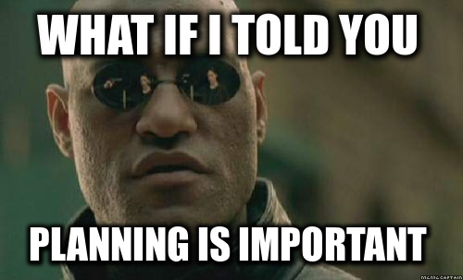
#1 – Plan business trip with clear objectives in mind
Notes:
1) It starts with planning a business trip. Company policy should encourage intentional
+ deliberate business travel. Managers should work with employees to clearly define and discuss trip goals before taking off (GM doesn’t have a role in this initial conversation). Helps employee understand dates, duration of stay, purpose.
-Not being thoughtful about duration of stay in country, ins and outs, can easily get carried away when objectives not defined. Employees should never feel like they’re on a one way ticket somewhere with no understanding of when they’ll need to come back.
-Can lead to flagging/too much time spent in-country
-Having a company culture about setting objectives is the first step in successful corporate business travel planning.

Slide 11

#2 – Establish a strong Global Mobility presence in your business
Notes:
2) Establish a strong GM presence in your business and market your team as a resource that stakeholders can rely on. This is so that business can succeed, compliance can be maintained, business travelers to be protected. Teams across the business should not operate in silos but in synergy with the GM team as the SME for business travel and immigration. But they’re not going to just come to you, GM needs to market itself as a presence. Palantir does it by:
Hosting regular AMAs (‘ask me anythings’):
1) we present business travel guidance and the distinction from productive work;
2) current events and how they’re impacting border friction;
3) market the many services our team can assist with and many ways we can be contacted.
-Not only do we hold AMAs for b-travelers, we hold AMAs for other departments and international business leads: Recruiters, Resourcing. Onboarding and Orientation.
Emphasis on training and education
Work with security in order to get a heads up for dangerous locations

Slide 12
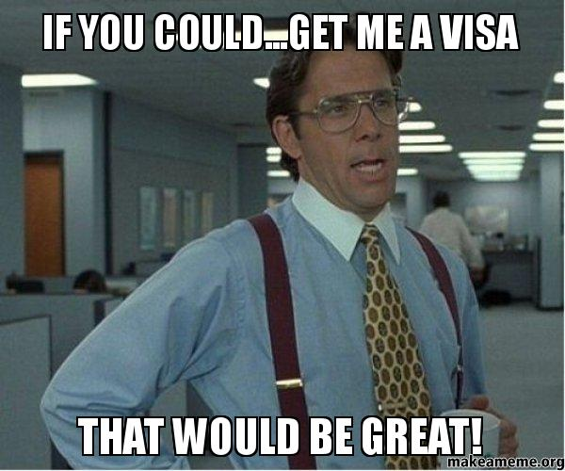
#3 – Educate and coach business travelers
Notes:
3) Communication is key. There needs to be a strong program of education for business travelers.
A. Individual traveler education: before every flight out, Palantir employees sit with a GM team member to go over the basics of travelling as a visitor: allowable activities + day count rules. These are always run by immigration counsel to make sure we’re in compliance.
B. Roundtable education for group travel: involves group leader + stakeholders, and GM (the SMEs!)
-Get timeline of planned travel into a country, full breakdown of the planned activities in-country, allows us to determine an immigration strategy, set expectations, not overpromise. We’re adamant about understanding timelines for when specific activities will be performed to ensure people are equipped with the proper visa. We flag any blockers or issues that might complicate travel. Important to really be in tune with understanding project timelines (which weeks are scoping activities, which are actual productive work) so that employees that we can prepare for future work authorization. If we anticipate a business trip to lead into productive work, we can pull the employees back, have them obtain the proper work authorization before future travel.
-Standardized templates so that all GM team members can summarize / relay travel guidance following our discussions. Comms are consistent whether you get the info from me or someone else. A lot of info can be overwhelming especially for less frequent business travelers- summaries help reinforce concepts discussed and empower employees to have peace of mind knowing that they’re in compliance when they travel.
Offer them tools in addition to procedures
Pro-active approach in 2017
Jillian:
Tax Example – International tax team works with the tax provider – elaborate on this
Brent:
Follow up to example: Often there is a disconnect so a corporate tax department working with the provider on issues is great

Slide 13

#4 – Equip employees with the right tools upfront
Notes:
4) Set your employees up for success. There are a number of tools that can help facilitate smoother entry into a country for business travel.
-pocket letter, business traveler’s insurance, business card, round trip travel itinerary showing departure out of the country, contact info of security team in case something goes wrong.
Carrying business cards: do or don’t?
Brent:
Recommends adding tax to it as fore warning to help avoid problems down the road
If you are getting paid for the day it is acceptable for tax
Andrea:
Proper language is most important, EEs need to be coached on what to say
There is a difference between a “business visit” and a “working day”
SEGWAY to next slide, What is a Work Day?

Slide 14

What is a Work Day?
Notes:
Andrea – poll audience as to what they think a work day is?
The question depends on who is asking
Ex. If your immigration agent is asking, what are you going to be doing?

Slide 15
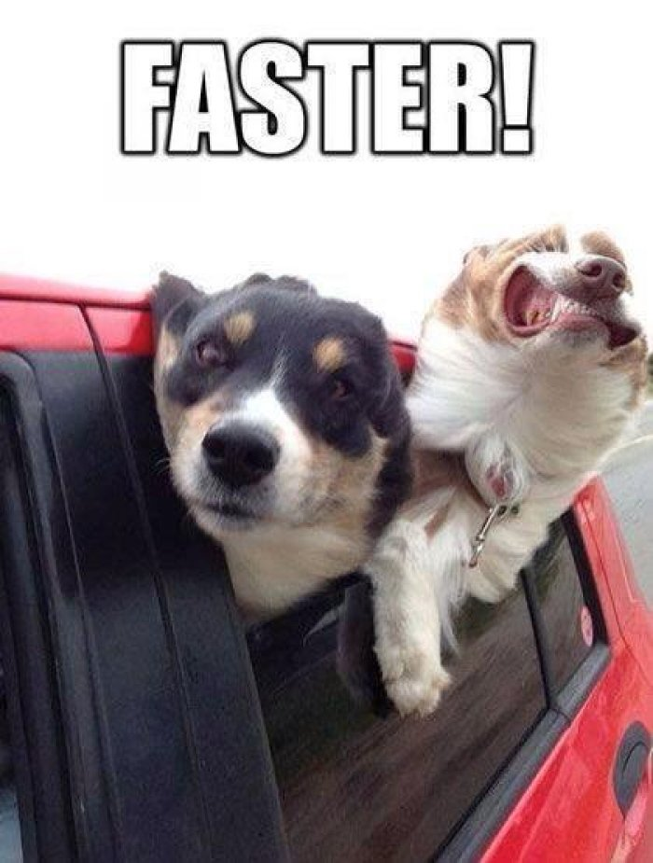
#5 – Familiarize with accelerated/fast track programs in various countries
Notes:
5) Familiarize with accelerated/fast track programs in various countries. In some countries, incentive programs exist to encourage and facilitate business travel. Sometimes these programs allow business travelers to bypass manual border security in favor of automated border security through e-gates and fast lanes. Other times they reduce business visa processing times for individuals who qualify. What this does is facilitate a smoother entry of pre-cleared individuals.
Registered Traveller (UK): Enter via EU/UK lanes or e-passport automated gates
EasyPass-RTP/EasyPass (Germany): Enter via EU lanes or e-passport automated gates
Orange Carpet Program (Netherlands): Expedited visa processing for frequent NL travelers
Red Carpet Scheme (Denmark): Expedited visa processing for Indian nationals of Indian companies
More and more tools out there that people aren’t aware of
Good to understand what incentives are out there to facilitate business travel while staying in compliance. Benefits: reduces time to entry (thus managing business expectations), eliminates border friction, helps business and employee.
Your company can explore options for bridging relationships with external govts. (UK Premium Sponsor program). Programs offer an additional layer of service for strengthening your program and promoting compliance.

Slide 16

#6 – Be sensitive to the comfort level of your employee
Notes:
6) Be sensitive to the comfort level your employee.
-Our employees are younger, it’s their first time traveling. As a support team, many times we are the first ones they talk to about traveling internationally. We check in to make sure they know all the different teams they can connect to when abroad, calm down their jitters when visiting somewhere we don’t have an office and they might be on their own and with a small number of team members.
-Employees sometimes have very different conceptions of what constitutes “work” requiring a work permit. You can provide the employee with all the information but at EOD, never want to put an employee in a situation that they can feel uncomfortable in.

Slide 17

#7 – Where possible, kick off work permits for optionality
Notes:
7) Where possible, explore work permits for “optionality”
If it’s unclear from the outset that an employee will need to spend extended time in-country. Some countries allow for easier options to do this, such as the ICT visa option in the UK for eligible applicants. This is more common for our commuter employees who frequently cross borders. Whenever an employee prepares to travel somewhere, we connect them to those teams to make sure they can chat through any implications about excessive travel, tax implications coming to mind.
Tier 2 ITC or EBT ext. biz traveler Brent – what tax advice would you give, which would be the better option? 9 times out of 10 it would not have impact on your tax, tax consequences that are much worse then a country to get into would be. Again ask yourself, what is a work day?
Tax Clock and Immigration Clock aren’t coupled.

Slide 18

#8 – Keep up with current events
Notes:
8) Keep current on current events.
Brexit, Trump administration. We are operating in a world where immigration laws are literally changing overnight. Things are trending to more conservative in some places while other places are opening their doors, it’s important to keep up to speed with the help of your immigration counsel so you can anticipate changes.

Slide 19
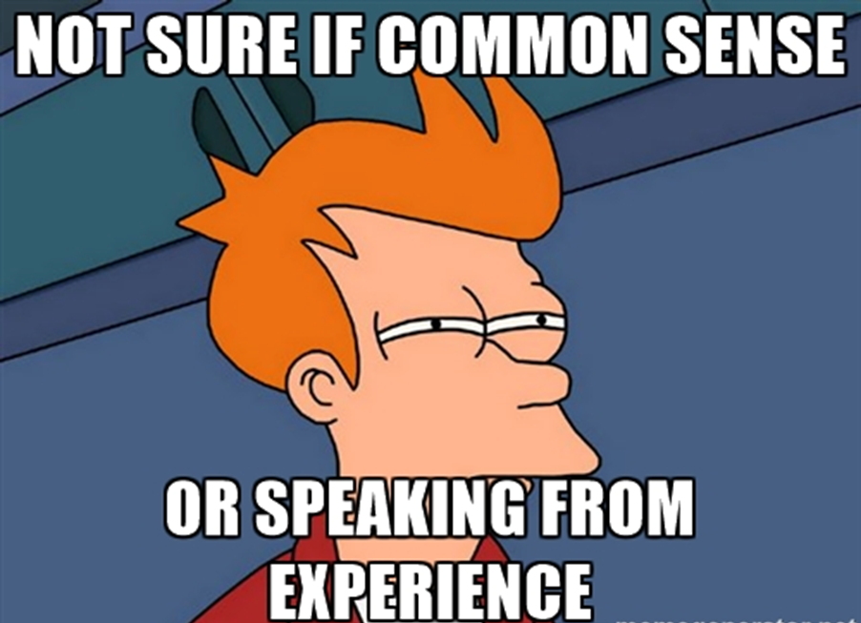
#9 – Gather context by experiencing for yourself
Notes:
9) Try to experience it yourself.
It helps when you have context about what happens when crossing international borders. Personal experience gives you more empathy for people who are frequent travelers and helps you understand their needs. I will never forget the first time I waited for 3 hours at Heathrow entering customs - you know that the registered traveler program is something we really promote at Palantir following that experience. Some context you can get only when experiencing it for yourself.

Slide 20
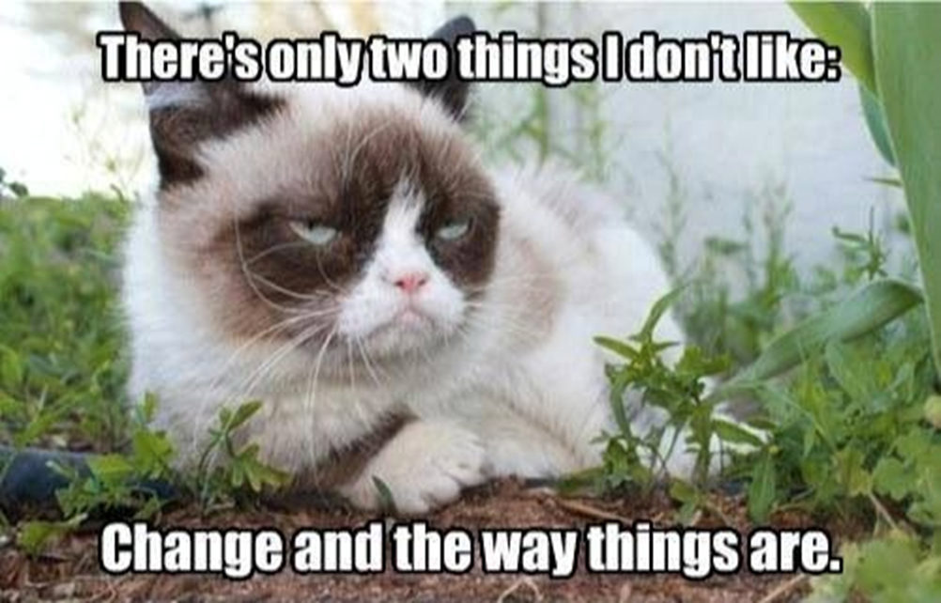
#10 – Don’t be afraid of change
Notes:
10) Don’t be afraid of change.
As growth happens in your company and international laws change, we need to review whether our processes are remaining compliant and scale to company’s growth. Important to be flexible and to move with the changes. We had two people. And when we have 2000 people, we need to have to match it with staffing on the GM Team. Improve on workflows, reviewing to make sure procedures make sense, are compliant.

Slide 21

BONUS – Don’t forget to lean on outside counsel
Notes:
10/11) Last but not least, lean heavily on immigration / employment / tax counsel to ensure a healthy business travel program.
In my opinion, it never hurts to over-communicate or over ask. Protects your company and your people. Group hug!

Slide 22

So what is the solution?
Leverage technology. Everyone carries a smart phone.
Subscribe as an organization to an Immigration Group or Tax Group who has the ability to deliver Smart Phone GPS tracking of the EE regardless of location as an automatic feature of using the app.
Notes:
An app that allows the user to manually input data, ultimately defeats the “easy button” effect that the current generation of travelers are looking for when they turn to technology.
Allow the data to flow to your HRIS system and or to your tax provider – or work with a data aggregator who collects data from the multiple sources, such as travel team, immigration group, personnel logs etc. and cumulatively aggregate all the data into one easy to use reporting tool.

Slide 23
Questions and Answers.
Open Discussion.
Notes:
10 minutes for Q&A

